Slide 1


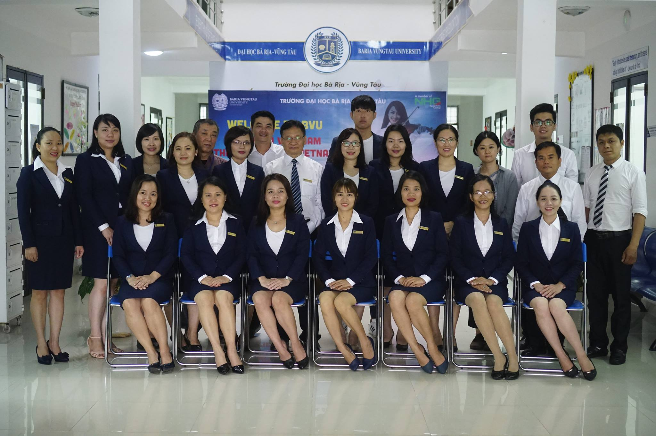

Slide 2

AMERICAN JETSTREAM PRE-INTERMEDIATE B

Slide 3
TEACHER’S PERSONAL INFORMATION
Name: Nguyen Thanh Loan
Facebook: Loan Nguyễn Thanh
Mobile number: 0942 255 937
Email: loannguyenthanh1978@gmail.com

Slide 4



UNIT 10
The news and journalism

Slide 5
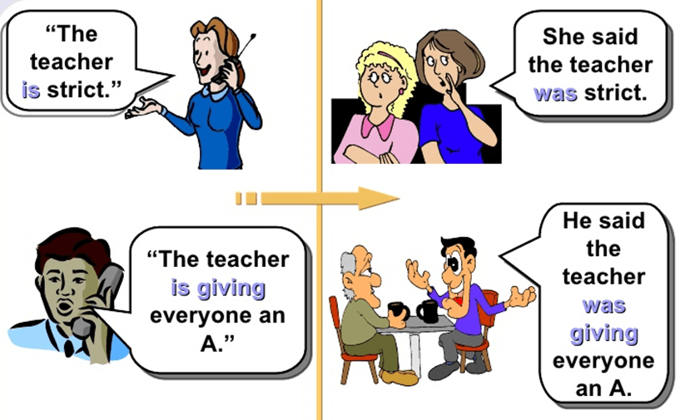
LESSON 2
She said / He said……..

Slide 6
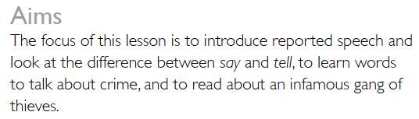
LESSON 2
She said / He said……..

Slide 7

VOCABULARY
Crime
detective
/dɪˈtek.tɪv/
someone whose job is to discover information about crime and find out who is responsible for them.
Ex: During the investigation, two detectives assumed the identities of antiques dealers.

Slide 8


VOCABULARY
Crime
crime
/kraɪm/
illegal activities
Ex: He has admitted committing several crimes, including fraud

Slide 9

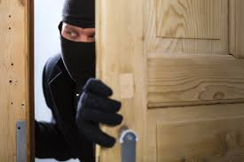
VOCABULARY
Crime
thief
/θiːf/
a person who steals
Ex: The art gallery was broken into last night, and the thieves got away with two valuable paintings.

Slide 10

VOCABULARY
Crime
A robber
/ˈrɒb.ər/
a person who steals
Ex: The robbers shot a policeman before making their getaway.

Slide 11

VOCABULARY
Crime
jewelry
/ˈdʒuː.əl.ri/
decorative objects worn on your clothes or body that are usually made from valuable metals, such as gold and silver, and precious stones
Ex: They stole jewelry valued at $50 000

Slide 12
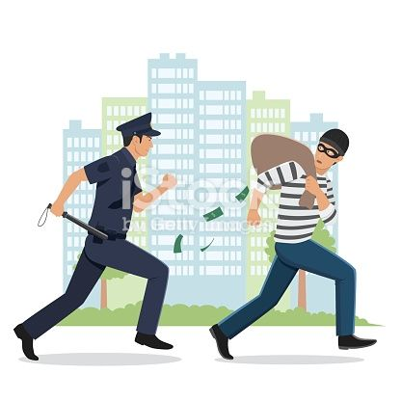
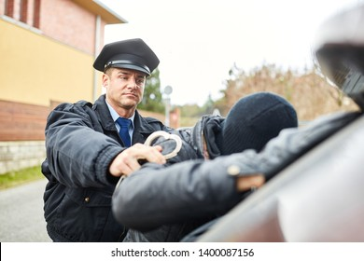
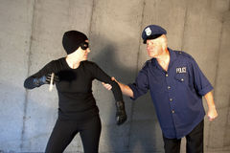
VOCABULARY
Phrases about crime
to catch…..
to catch a criminal
to catch a robber
to catch a thief

Slide 13
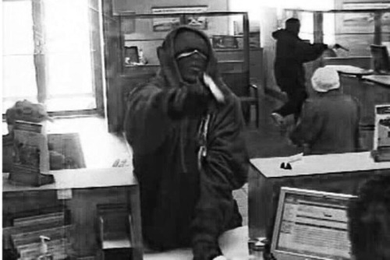
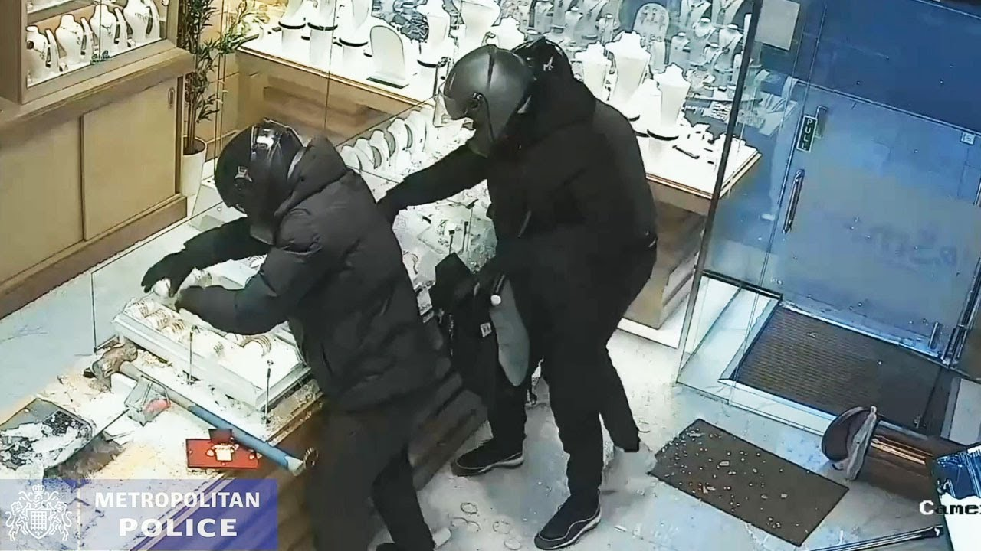
VOCABULARY
Phrases about crime
to rob…..
to rob a bank
to rob a jewelry shop

Slide 14
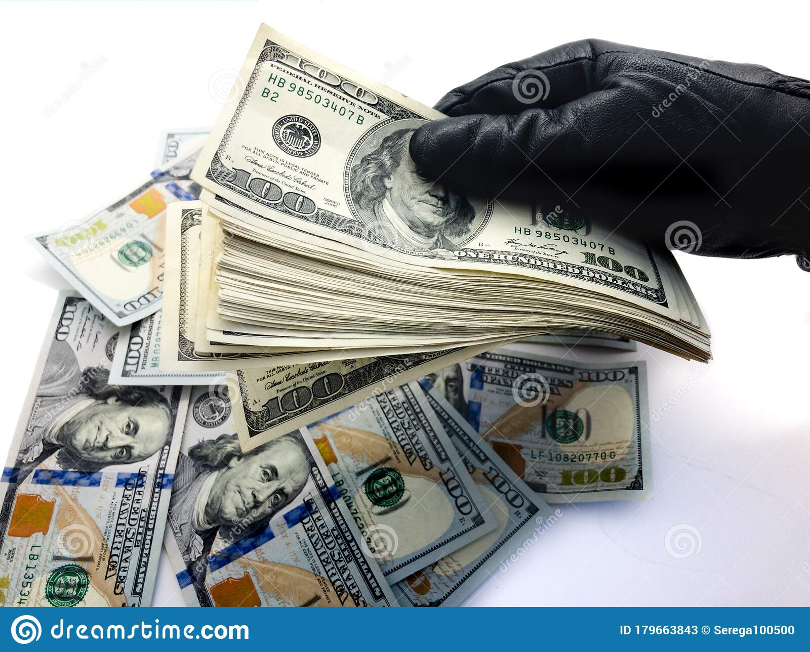

VOCABULARY
Phrases about crime
to steal…..
to steal jewelry
to steal money

Slide 15
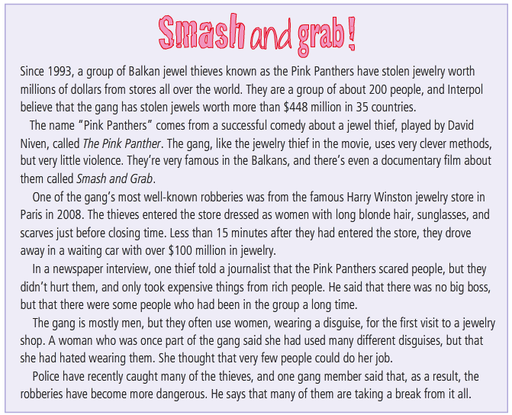
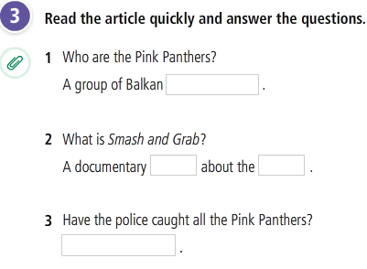
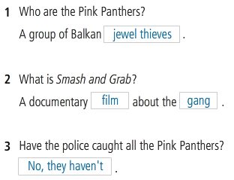
READING
SMASH AND GRAB

Slide 16
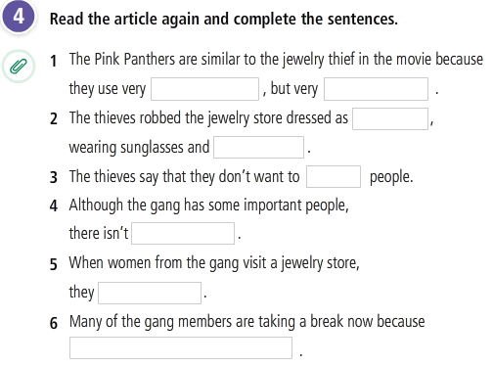
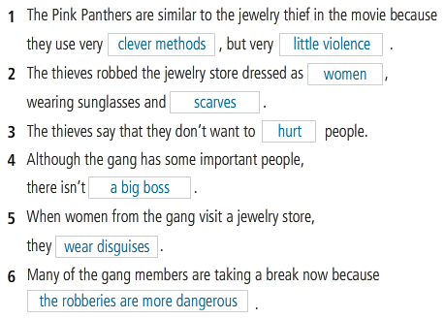
READING
SMASH AND GRAB

Slide 17
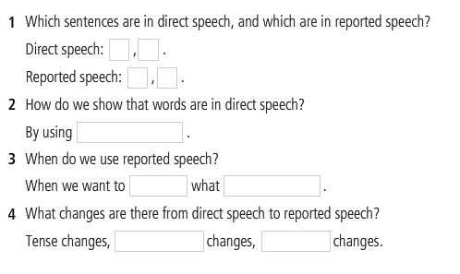
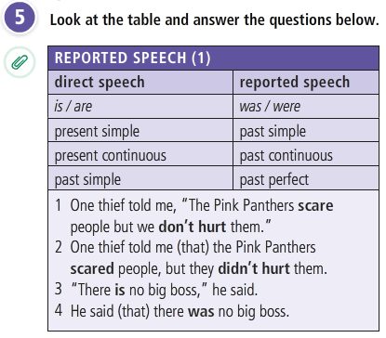
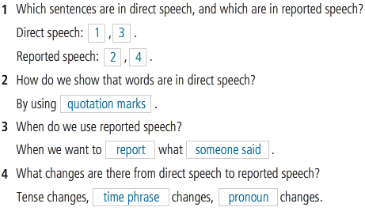
GRAMMAR
REPORTED SPEECH

Slide 18
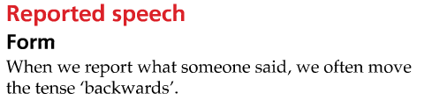
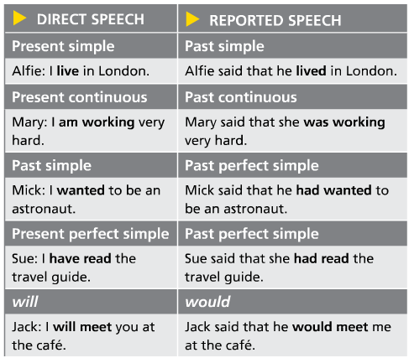
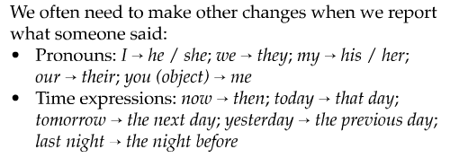
Grammar

Slide 19
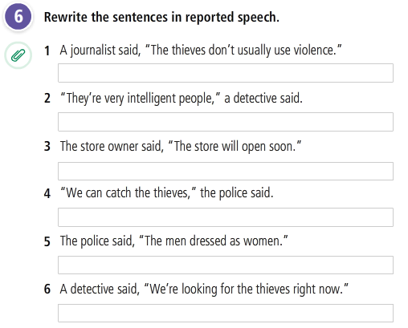
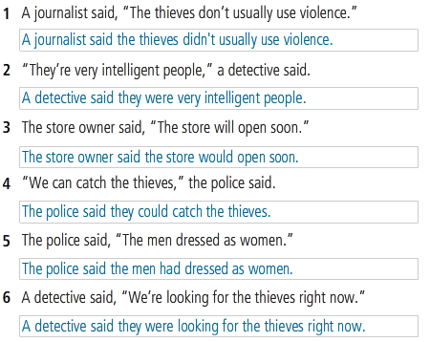
GRAMMAR
REPORTED SPEECH

Slide 20
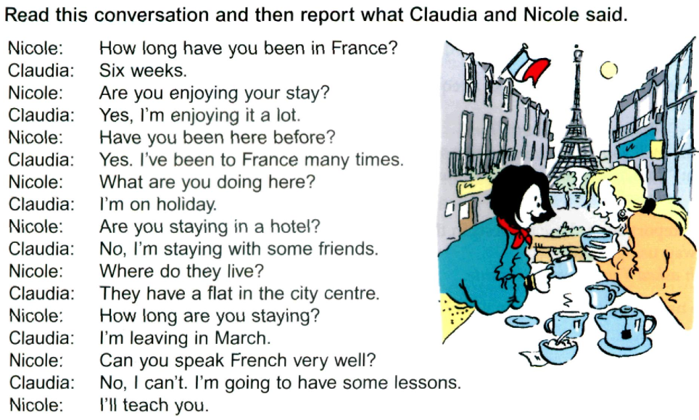
GRAMMAR
REPORTED SPEECH

Slide 21
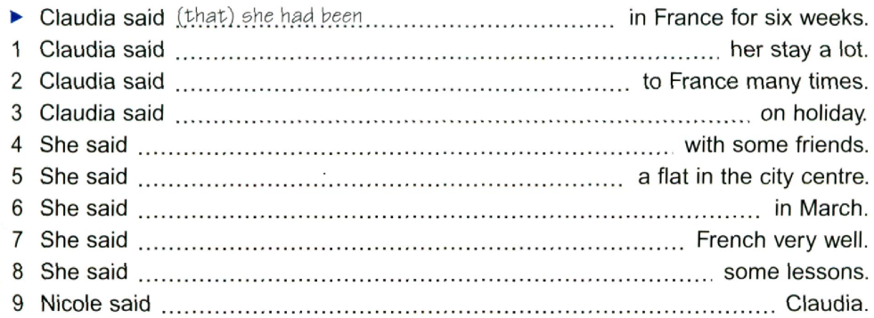
GRAMMAR
REPORTED SPEECH

Slide 22
GRAMMAR
REPORTED SPEECH

Slide 23
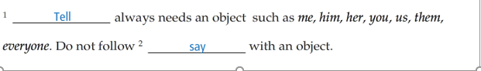
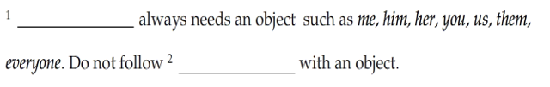
GRAMMAR
Say / tell

Slide 24
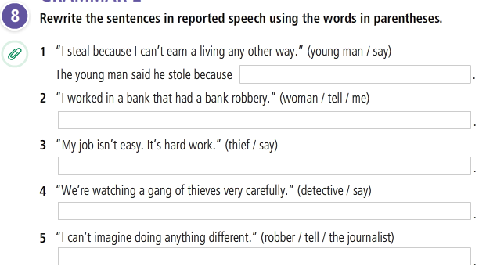
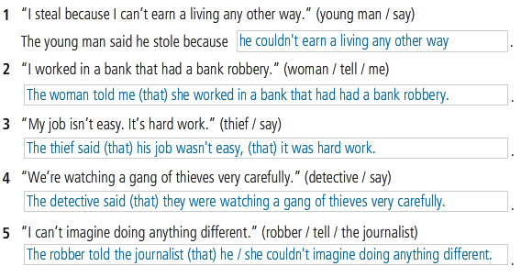
GRAMMAR
Say / tell

Slide 25
REFERENCES
Vocabulary: Crime
https://www.youtube.com/watch?v=6kA0RjrE2ug
https://www.youtube.com/watch?v=H1b2ptZvqR0
https://www.englishlessonviaskype.com/crime-and-punishment-vocabulary/
Grammar: Reported speech
https://www.youtube.com/watch?v=XFvdVmpIaRA&t=584s
Listening and speaking
https://www.youtube.com/watch?v=0VzDQPeHFNM

